Slide 1
A further comparison of fundamental frequency tracking algorithms
Hongbing Hu, Peter Guzewich, Stephen Zahorian
Department of Electrical and Computer Engineering
SUNY -- Binghamton University

Slide 2
Outline
Review of Yet Another Algorithm for Pitch Tracking (YAAPT)
Modifications to YAAPT
Speed/Accuracy improvements
Interpolations through unvoiced regions
Experimental evaluations
Tracking accuracy
Tone classification for Mandarin
Summary

Slide 3
YAAPT block diagram
Notes:
From JASA paper-- should note on slide

Slide 4
YAAPT example
Notes:
NLFER: Normalized low frequency energy ratio

Slide 5
Algorithm modifications
Subject to user-specified thresholds, some F₀ values are considered “outliers” and corrected
Accuracy of spectral pitch track improved
Inefficient inner loop changed for about 20% reduction in computational time
Eliminated some potential errors due to input parameter settings out of range

Slide 6
Algorithm modifications (continued)
Biggest change is for case when final track is to be considered all voiced
On first pass, “best” track is found with voicing decisions made
The voiced regions are used to compute a smooth transition through unvoiced regions using third order polynomial interpolation
The original voiced sections are recombined with the interpolated values with some additional smoothing
Same parameter settings are now used for best track with voicing decisions and best all-voiced track

Slide 7
Comparison

Slide 8
Experimental Evaluation
Two databases
Keele database (5F, 5M, ~6 minutes, British English)
Japanese database (14F, 14 M, ~40 minutes)
Three pitch trackers
YAAPT
PRATT
YIN
Two error measures
GROSS error (based on voiced regions only)
BIG error (voiced region errors + voicing decision errors)
Multiple bandwidths, noise types, and noise levels
Notes:
Typically 20% difference considered errors.
There are also fine errors, but those not considered in this paper

Slide 9
Experimental results--Keele database
Gross Error
 | Studio |  |  | Simulated telephone
Method | Clean | W-5 | B-5 | Clean | W-5 | B-5
YAAPT | 3.07 | 3.44 | 7.87 | 4.56 | 6.37 | 28.23
PRAAT | 5.22 | 7.79 | 17.23 | 11.18 | 14.27 | 29.84
YIN | 2.95 | 4.57 | 14.82 | 21.07 | 27.30 | 38.52
Big Error
 | Studio |  |  | Simulated telephone
Method | Clean | W-5 | B-5 | Clean | W-5 | B-5
YAAPT | 6.14 | 8.06 | 21.71 | 14.04 | 16.82 | 43.80
PRAAT | 8.72 | 19.90 | 34.20 | 15.34 | 21.29 | 47.45
YIN | - | - | - | - | - | -

Slide 10
Experimental results--Japanese database
Gross Error
 | Studio |  |  | Simulated telephone
Method | Clean | W-5 | B-5 | Clean | W-5 | B-5
YAAPT | 1.83 | 2.87 | 3.96 | 4.43 | 7.27 | 24.37
PRAAT | 4.08 | 5.93 | 15.44 | 6.38 | 11.20 | 28.72
YIN | 1.69 | 2.92 | 13.03 | 14.46 | 20.96 | 34.51
Big Error
 | Studio |  |  | Simulated telephone
Method | Clean | W-5 | B-5 | Clean | W-5 | B-5
YAAPT | 4.99 | 7.16 | 15.33 | 12.16 | 17.10 | 35.07
PRAAT | 7.12 | 17.89 | 30.96 | 10.06 | 23.26 | 43.81
YIN | - | - | - | - | - | -
Notes:
Some of these results are better than jasa paper result-- some are worse

Slide 11
Tone recognition experiments
Mandarin tones
4 tones (high, rising, dipping, falling) (neutral tone not considered)
Database
RASC863 (Shanghai region) database
5 feature sets (segment lengths: 100ms to 800ms)
DCTC/DCSC features (35 features, 5 DCTCs x 7 DCSCs)
Pitch alone (7 features, encoded with 7 DCSC terms)
Normalized pitch (7 features)
DCTC/DCSCs + pitch (42 features)
DCTC/DCSCs + normalized pitch (42 features)
Neural network classifier
Notes:
1. Spectral trajectory features only (35 features): computed with 5 DCTC terms each encoded with 7 DCSC terms, from a frequency range of 50 Hz to 800 Hz. These particular conditions were determined empirically from pilot tests, and are also consistent with observations of spectrograms that indicate tonal information is most easily observed in the low frequency region over segments longer than 100 ms. May have to give brief explanation of DCTCs and DCSCs-- I should give you a few backup slides for this--saz
2. “Raw” pitch trajectories (7 features): encoded with 7 DCSC terms. The DCSC method is a parametric method to represent a smooth trajectory efficiently.
3. Normalized pitch trajectories (7 features): also each encoded by 7 DCSC terms. The normalization is accomplished by first computing the mean and standard deviation of the pitch over the entire sentence from which each tone segment is extracted. These mean values are then subtracted from pitch values in each segment, and the resultant values divided by the standard deviation.
4. A combination of feature sets 1 and 2. (42 features)
5. A combination of feature sets 1 and 3. (42 features)

Slide 12
Automatic Tone Recognition
YAAPT
YIN
Notes:
The features obtained with the YAAPT result in considerably higher tone recognition accuracy than for pitch features obtained with the other two trackers except for the shortest segment length tested (100 ms). The highest accuracy obtained with YAAPT based pitch tracks (76.9%) is 4.1% higher than the highest accuracy obtained with YIN (72.8%) and 5% higher than the best result obtained with PRAAT (71.9%), and higher than the accuracy of humans for recognizing context-free tones [8] (~75%).
Although pitch features are most important for tone recognition, the addition of spectral shape trajectory features improves accuracy by about 5%.
Pitch normalized features are more effective than raw pitch features, at least for YAAPT for shorter segment lengths. For the case of YIN and PRAAT, and YAAPT for long segment lengths, pitch normalization doesn’t demonstrate advantage.
Tone recognition accuracy improves as segment length increases, showing the importance of the long temporal variation.

Slide 13
Automatic tone recognition--comments
Spectral shape trajectory features give significant improvement to using pitch only features
Pitch normalization (based on mean and standard deviation of pitch for each sentence) gives large improvements for short segment lengths, but not for long segment lengths
Pitch tracks computed from YAAPT are considerably more effective for tone recognition than tracks computed from YIN or RAAPT—see next slide for possible explanation

Slide 14
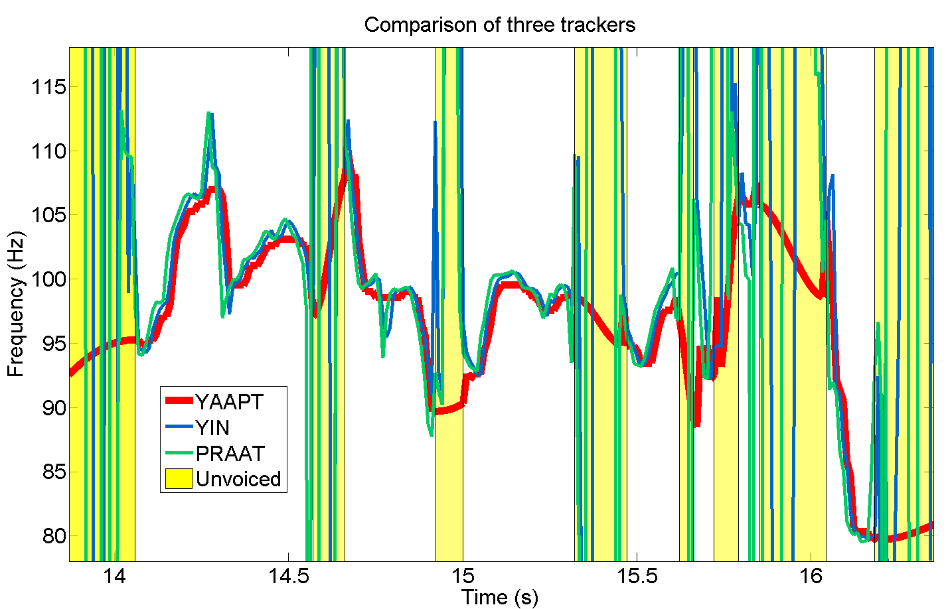
Comparison
Notes:
Speculation-- YAAPT does better for tone classification than RAAPT or YIN primarily because interpolations thru unvoiced region are better

Slide 15
Summary
YAAPT MATLAB Function
[Pitch, frms, rate] = yaapt(Data, Fs, VU, ExtrPrm… )
ExtrPrm can be used to adjust things such as min and max search ranges for pitch—default parameters used for all cases tested here
YAAPT code is available at
www.ws.binghamton.edu/zahorian/yaapt.htm

Slide 16
Questions?

Slide 17
Backup

Slide 18
Spectral-Temporal Features
Discrete Cosine Transform Coefficients (DCTCs)
Spectral features
A midifed Cosine transform of log magnitude spectrum
Use a frequnecy warping to simulate the nonlinearity of the human ear in speech perception (e.g., Mel Scale)
Discrete Cosine Series Coefficients (DCSCs)
Temporal features
A Cosine series expansion over time using overlapped blocks of DCTCs
Capture the changes of each feature component from frame to frame

Slide 19
DCTC Features
DCTC Computation
Given the spectrum X with the frequency f normalized to a [0, 1] range, the ith DCTC is calculated:
a(X): nonlinear amplitude scaling (log)
g(f): nonlinear frequency warping (Mel-like function)
Basis vector :
First 3 DCTC basis vectors

Slide 20
DCSC Features
DCSC Computation
Represent the temporal evolution of DCTCs over time
h(t): time “warping” function—non-uniform time resolution
Basis vectors:
First 3 DCSC basis vectors

